Slide 1
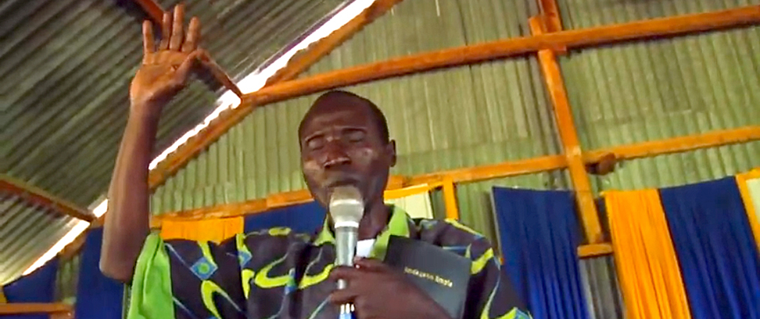
Bible Translation Educator Series
Introduction

Slide 2
Some Topics in This Series
Meaning-Based Bible Translation
Church-Owned Bible Translation
The MAST Bible Translation Process
Scripture Engagement

Slide 3


